Slide 1
PLTW Mechanical Gears

Slide 2
What do a guitar, a bicycle, an eggbeater, and a sewing machine have in common?
They all use gears to increase, decrease, or redirect power.

Slide 3
Gears can be found in many different sizes. A mechanical wind-up watch has very small gears, while the gears used to lift a bridge to allow ships to pass underneath are huge in comparison.

Slide 4
Different gear configurations are used for different purposes.
Notice the ten different gear assemblies in this presentation and think about how they might be used.

Slide 5
Mechanical Gears
Universal Joint
Bevel Gear Assembly
Simple Gear with Idler
Worm and Wheel
Crown and Pinion

Slide 6
Mechanical Gears
Rack and Pinion
Lead Screw
Pulley and Belt
Cam and Follower
Crank and Slider

Slide 7
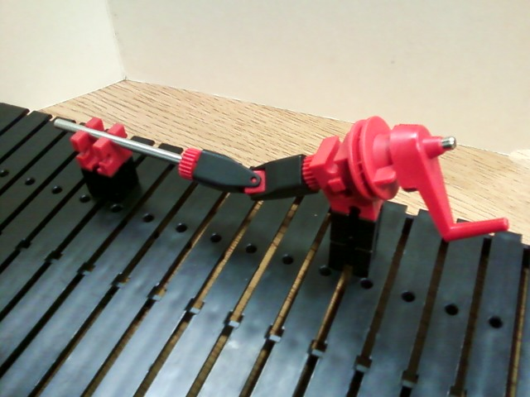
Universal Joint

Slide 8
Universal Joint
Working angular range between the input shaft and the output shaft: 0º to 45º
Speed is constant.
Torque is constant.
The speed ratio equals 1:1

Slide 9
Universal Joint
The flow of power is reversible.
This means the original input shaft (with crank) can be turned by the output shaft.
The input shaft and output shaft…
Do they turn in the same direction or
opposite direction?
The direction of travel is reversible.
Example: The “drive train” on a car

Slide 10
Universal Joint

Slide 11
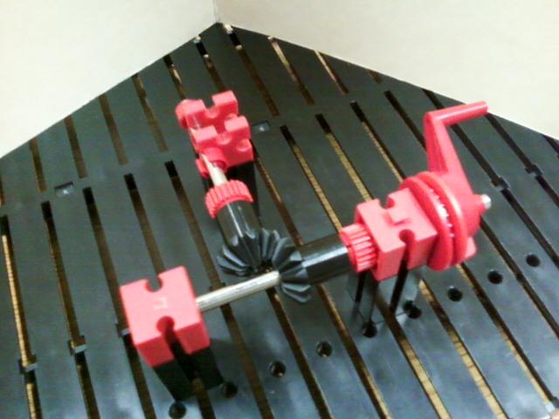
Bevel Gear Assembly

Slide 12
Bevel Gear Assembly
There is a 90º difference between the input shaft and output shaft.
Speed is constant.
Torque is unchanged.

Slide 13
Bevel Gear Assembly
Is the flow of power reversible?
Can a person turn the output shaft to make the input shaft turn?
Is the direction of travel reversible?
Can the crank be turned in opposite direction and make the output turn in the opposite direction?
The gear ration is 1:1 (“one to one”)
Example: hand mixer or “old-fashioned” egg beater

Slide 14
Bevel Gear Assembly

Slide 15
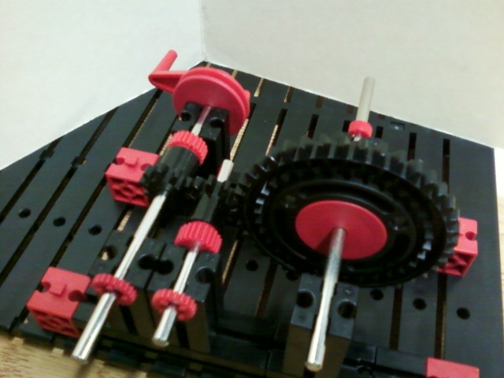
Simple Gear with Idler

Slide 16
Simple Gear with Idler
Compare position of input shaft to output shaft: parallel
Speed is decreased.
Torque: increased? decreased? constant?
Gear ratio is 4:1

Slide 17
Simple Gear [train] with Idler
The flow of power…
Compare the direction of travel between the input gear and the output gear.
What would happen if we removed the idler gear from this system?
Would the direction of travel be affected?

Slide 18
Simple Gear [train] with Idler
Is the flow of power reversible?
Is the direction of travel reversible?
If we remove the crank from the smaller gear and attach it to the larger gear, (reversing the flow of power) how would that affect speed and torque?

Slide 19
Simple Gear [train] with Idler

Slide 20
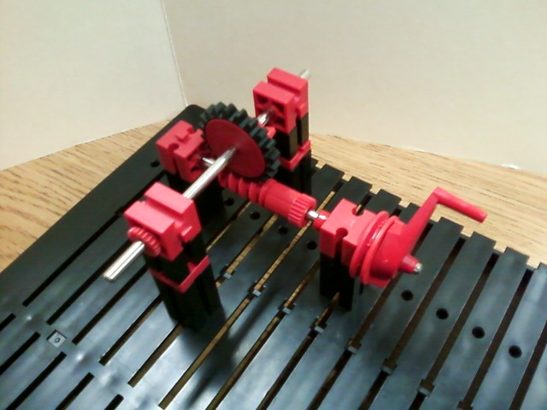
Worm and Wheel

Slide 21
Worm and Wheel
Input shaft is perpendicular to output shaft
Speed is decreased.
Torque: increased? decreased? constant?
Gear ratio is 20:1

Slide 22
Worm and Wheel
The flow of power is not reversible.
The input cannot be turned by the output.
The direction of travel is reversible.
We can turn the crank in the other direction to make the gear turn the other direction.
Example: string tightener on a guitar

Slide 23
Worm and Wheel

Slide 24
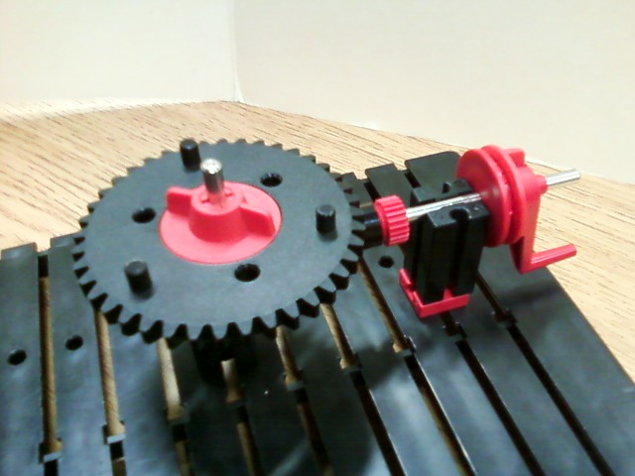
Crown and Pinion

Slide 25
Crown and Pinion
Input shaft is perpendicular to output shaft
Speed is decreased.
Torque is increased.
What is the gear ratio?

Slide 26
Crown and Pinion
The flow of power is reversible.
Pinion gear (and crank) can be turned by the crown gear.
The direction of travel is reversible.
Crank can turn the crown gear opposite way.
Example: remote control car
(turn wheels left or right)

Slide 27
Crown and Pinion

Slide 28
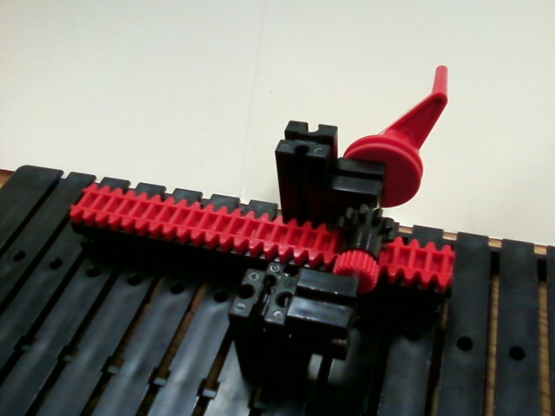
Rack and Pinion

Slide 29
Rack and Pinion
Type of input movement…?
Type of output movement: Linear
The track moves a distance of 1.75 inches with one complete rotation of the crank
If the pinion gear (near crank) diameter were increased, would the track move a longer or shorter distance?

Slide 30
Rack and Pinion
The flow of power is not reversible.
The direction of travel is reversible.
Example: Steering system on
some vehicles

Slide 31
Rack and Pinion

Slide 32
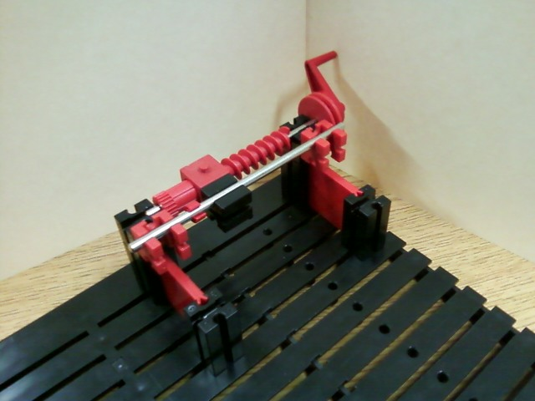
Lead Screw

Slide 33
Lead Screw
Type of input movement: Rotary
Type of output movement: Linear
How many revolutions of the crank are necessary to move the block 1 inch?
Answer: about 5¼ turns of the crank

Slide 34
Lead Screw
The flow of power is not reversible
You cannot make the lead screw and crank turn by moving the block.
Speed is increased on the output end.
Is the direction of travel is reversible?
Example: vice on work benches (tables)

Slide 35
Lead Screw

Slide 36
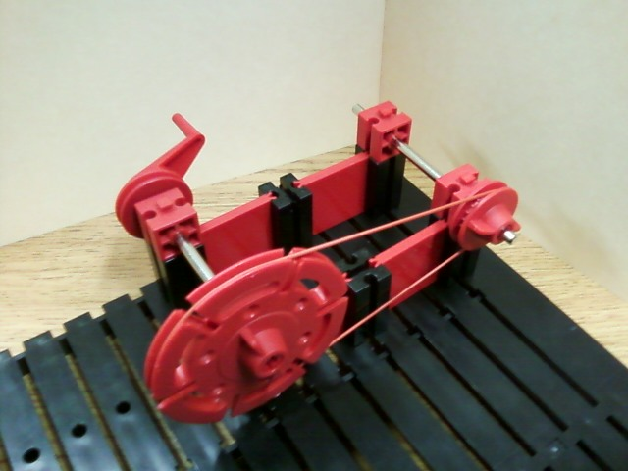
Pulley and Belt

Slide 37
Pulley and Belt
Input shaft and output shaft are parallel
Torque is decreased (in this example)
Speed is increased (in this example)
Input to output ratio: 1 to 2.5

Slide 38
Pulley and Belt
The flow of power is reversible.
The direction of travel is reversible.
The input shaft and the output shafts turn in the same direction.
If the belt is crossed, what happens?
Example: Bicycle

Slide 39
Pulley and Belt

Slide 40
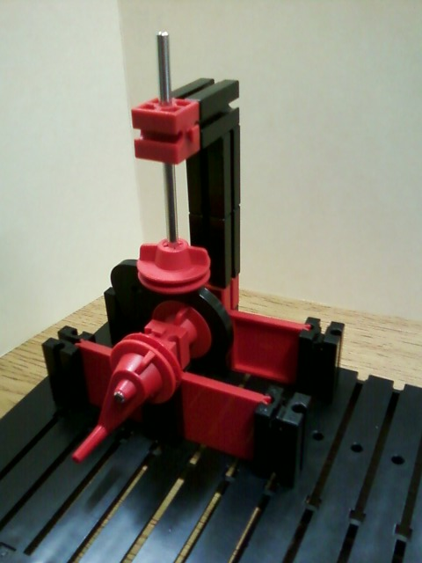
Cam and Follower

Slide 41
Cam and Follower
The input movement is what type?
Answer: ROTARY
The output movement is what type?
Answer: LINEAR
The “follower” moves up and then down
ONE time with one revolution of the crank

Slide 42
Cam and Follower
The direction of travel is reversible
The follower can be moved by turning the crank in the opposite direction. Although, the type of movement of the follower remains the same.
The flow of power is NOT reversible
The cam and crank cannot be moved by the follower.
Example: Valve in an engine

Slide 43
Cam and Follower

Slide 44
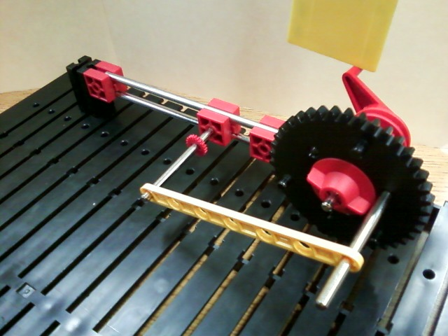
Crank and Slider

Slide 45
Crank and Slider
The input of this type of system is (requires) a ROTARY movement.
This type of system produces an RECIPROCATING movement.
The slider moves approximately 1.5 inches with each full turn of the crank.

Slide 46
Crank and Slider
What would happen if the diameter of the crank gear were increased….?
Would the slider move a shorter distance or a longer distance? Why?
The flow of power is not reversible
What about the direction of travel?
Example: choo-choo train?

Slide 47
Crank and Slider

Slide 48
Mechanical Gears
Universal Joint
Bevel Gear Assembly
Simple Gear with Idler
Worm and Wheel
Crown and Pinion

Slide 49
Mechanical Gears
Rack and Pinion
Lead Screw
Pulley and Belt
Cam and Follower
Crank and Slider

